Slide 1


Title
P.D. team
Development team: Rodrigo Juan Guillermo Daniel

Slide 2
Content
Introduction
Project Definition
Project Estimation
Project Planning
Project Monitoring and Control Procedure
General reflection aspects on the project planned at the team level
Specific reflection aspects of the planned project at the team and individual or personnel level
Conclusions

Slide 3
Introduction

Slide 4
Project Definition

Slide 5
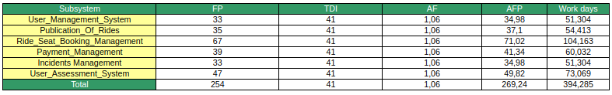
Project Estimation

Slide 6
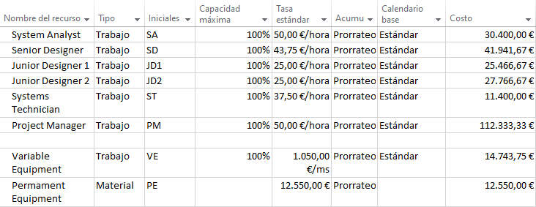
Project Planning: Organizational Structure

Slide 7
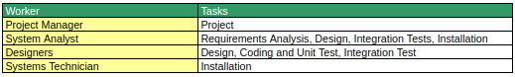
Project Planning: Assigned Qualified Personnel

Slide 8
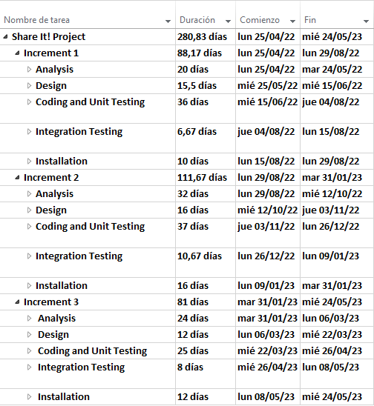
Project Planning: Time Management

Slide 9
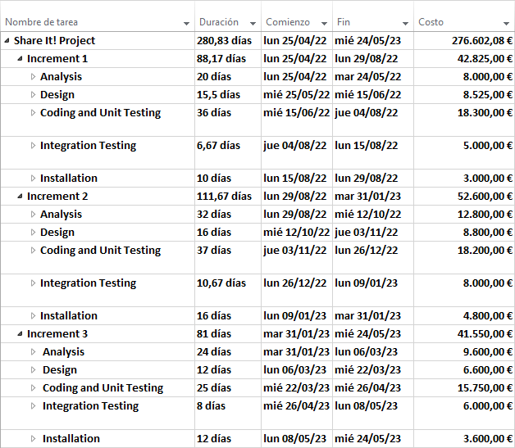
Project Planning: Costs Management

Slide 10
Project Monitoring and Control Procedure
Increment meetings with client:
Increment 1 - 29/08/2022
Increment 2 - 31/01/2023
Increment 3 - 24/05/2023 (Final Product)
Internal team meetings
TBD - Last meeting

Slide 11

General reflection aspects on the project planned at the team level
Difficulties
Acquired knowledge
Experience gained

Slide 12

Specific reflection aspects of the planned project at the team and individual or personnel level
Quality of the planned project
Adaptation
Completeness
Coherence

Slide 13

Specific reflection aspects of the planned project at the team and individual or personnel level
Procedure carried out to develop the Project Plan
Slice into tasks
Work in tasks
Revise
Put together

Slide 14


Specific reflection aspects of the planned project at the team and individual or personnel level
Team Management
Slice into tasks
Individual or group?
Assign team member / date

Slide 15

Specific reflection aspects of the planned project at the team and individual or personnel level
Individual or personal contribution in each of these three
aspects of the team members
Adaptation and Coherence
Completeness
Procedure of Project Plan
Team Management

Slide 16

Conclusions
What shows the document?
What is the project goal?
How much is going to cost?

